Slide 1
Portfolio Generator
👥 Team Details
SN
Sabbani Navyasri
2026
2303a510j1@sru.edu.in
DevFolio · AI-Powered Portfolio Generator · SRU · 2026

Slide 2
/ 01
Introduction
What is Portfolio Generator?
Portfolio Generator is an AI-powered developer portfolio generator that transforms a resume PDF into a stunning, downloadable portfolio website — in under 5 minutes, with zero design skills required. Built entirely with HTML, CSS and JavaScript using Copilot and Gemini for code generation.
📄
Parses resume PDF automatically using PDF.js to extract name, skills, projects & experience
🎨
Offers 20 unique professionally designed portfolio templates (dark, light, terminal, editorial...)
⚡
AI bio generator creates professional bios using Gemini/Copilot prompt-based integration
🧭
5-step guided wizard — Profile → Skills → Projects → Experience → Style
🔐
Complete auth system: Sign up, Login, Password Reset with localStorage session management
⬇
One-click download of a standalone HTML portfolio — host anywhere for free, no lock-in
5 min
20
AI
Free
Time to Portfolio
Templates
Bio Generator
No Subscription
DevFolio · AI-Powered Portfolio Generator · SRU · 2026

Slide 3
/ 02
Objectives
01
02
Automate Portfolio Creation
Resume PDF Parsing
Eliminate manual coding and design effort by auto-generating portfolio websites from resume data using intelligent parsing.
Use PDF.js to extract structured data (name, skills, experience, projects) automatically from any uploaded resume file.
03
04
AI-Powered Content Generation
Multiple Template Styles
Integrate Claude AI API to generate professional, personalized bio paragraphs based on the user's profile and skills.
Provide 20 distinct portfolio templates covering dark, light, terminal, editorial, minimal, retro, and cyber aesthetics.
05
06
Secure Authentication System
Downloadable Output
Implement full signup, login, and password-reset flow with localStorage-based session management and persistence.
Enable one-click generation of a standalone HTML portfolio file that can be hosted anywhere — no backend required.
DevFolio · AI-Powered Portfolio Generator · SRU · 2026

Slide 4
/ 03
Stakeholders
Who benefits from DevFolio?
🎓
💼
🏢
Students & Graduates
Job Seekers
HR / Recruiters
Build a portfolio without coding knowledge to stand out in placements, internships and job applications.
Create a professional online presence instantly by converting their resume into a visually impressive portfolio.
Quickly assess a candidate's technical profile through a well-structured, downloadable portfolio website.
📋
🏫
🛠️
Career Counselors
Placement Cells
Developers / Evaluators
Use DevFolio as a teaching and mentoring tool to guide students in self-presentation and portfolio building.
Deploy the tool institution-wide to prepare batches of students for campus placement and recruitment drives.
A well-structured full-stack project showcasing AI integration, resume parsing, auth flows, and template engines.
DevFolio · AI-Powered Portfolio Generator · SRU · 2026

Slide 5
/ 04
Programming Languages, Tools & Software
Frontend
AI Integration
Auth & Storage
HTML5 — Structure & semantic markup
Anthropic Claude API — Bio generation
localStorage — User accounts & sessions
CSS3 — Animations, variables, flexbox/grid
claude-sonnet-4 model
Session persistence across page loads
Vanilla JavaScript ES6+ — Core logic
Real-time fetch() API calls
Sign Up / Login / Password Reset flow
PDF.js (Mozilla) — Resume text extraction
JSON response parsing
Tab-toggle UI between auth modes
Syne · Outfit · JetBrains Mono — Fonts
Prompt engineering for bios
Email + Password validation
Portfolio Engine
Tools & Software
Design System
20 template renderers (dark + light)
VS Code — Code editor
CSS Custom Properties (theming)
Dynamic HTML string generation
GitHub — Version control
Dark / Light mode toggle
Base64 photo & resume embedding
Google Chrome DevTools — Debugging
Responsive grid & flexbox layouts
One-click HTML download via Blob
Claude AI — Code generation
Toast notification system
Accent color picker + presets
Google Gemini — Reference & research
Multi-step wizard with progress dots
DevFolio · AI-Powered Portfolio Generator · SRU · 2026

Slide 6
/ 05
Part 1 / 2
Prompts Used to Generate Code
Microsoft Copilot
PROMPT
OUTPUT
"Build a complete single-file portfolio generator web app in HTML/CSS/JS with a multi-step form wizard (Profile, Skills, Projects, Experience, Style). Include PDF.js resume parsing, 20 portfolio templates, auth system with localStorage, and a Generate button that builds a standalone HTML portfolio."
Generated the complete DevFolio application — all HTML structure, CSS variables, JS logic for the 5-step form wizard, template routing, and the buildPortfolio() function.
Google Gemini
PROMPT
OUTPUT
"Add an AI bio generation feature to the portfolio generator. When the user clicks AI Suggest, call the AI API with the user's name, title and skills, and fill the bio textarea with a professional 2-sentence bio in first person. Handle errors gracefully."
Generated the aiBio() function with fetch() to the AI API endpoint, dynamic prompt construction, JSON response parsing, and textarea fill logic with toast notifications.
Microsoft Copilot
PROMPT
OUTPUT
"Write a resume PDF parser in JavaScript using PDF.js that extracts: full name (from first 5 lines, 2-4 capitalized words), email, GitHub/LinkedIn URLs, job title, location, skills (match against 38 tech keywords), education (degree/university/year), certifications, work experience with date ranges, and projects."
Generated the complete parseResume() and applyResume() functions with regex patterns, positional text sorting, smart name detection, and cert filtering logic.
DevFolio · AI-Powered Portfolio Generator · SRU · 2026

Slide 7
/ 05
Part 2 / 2
Prompts Used to Generate Code
Google Gemini
PROMPT
OUTPUT
"Create a complete auth system in JavaScript using localStorage. Include: sign up (name/email/password), login (validate credentials), logout, session persistence, password reset, and a tab-toggle UI between login and signup. Wrap in a full-screen overlay with a split-panel design (left: features list, right: form)."
Generated the full auth overlay HTML, authTab(), doLogin(), doSignup(), doReset(), checkAndInit() functions plus getUsers()/saveUsers()/getSession() localStorage helpers.
Microsoft Copilot
PROMPT
OUTPUT
"Generate 20 portfolio template renderers in JavaScript. Each takes a data object and returns a complete HTML string. Include: Midnight (dark radial), Carbon, Aurora, Terminal (monospace CLI style), Paper (print resume), Editorial, Minimal, Designer, Cyber, Brutalist, Glass, and more. Use Google Fonts and professional typography."
Generated all 20 template functions including darkPortfolio(), lightPortfolio(), and the terminal/paper special-layout renderers with full CSS, stats bars, and section layouts.
Copilot + Gemini
PROMPT
OUTPUT
"Style the entire DevFolio app with a dark theme using CSS custom properties. Use --bg:#050508, --accent:#6c63ff, --accent2:#ff6584. Add glassmorphism nav, animated gradient text, skill chip toggles, dynamic form steps with progress dots, color presets with hover animations, and a responsive mobile layout."
Generated all CSS variables, nav styles, auth overlay styles, card components, skill chips, step progress indicator, upload zones, and toggle switch — 450+ lines of CSS.
DevFolio · AI-Powered Portfolio Generator · SRU · 2026

Slide 8
/ 06
Workflow Flowchart
User Visits
Auth Check
Home Page
Upload Resume
Parse PDF
Auto-Fill Form
Browser
Login/Signup
Dashboard
PDF/DOC/DOCX
PDF.js engine
5-step wizard
Download HTML
Preview
Generate
Set Style
Add Projects
Fill Profile
Standalone file
In-browser iframe
buildPortfolio()
Color + Template
Step 3 + 4
Step 1 + 2
✦ AI Bio
Gemini / Copilot
Flow Legend
Auth & Navigation
Data Input
Output & Download
Styling & Templates
Form Steps
AI Processing
DevFolio · AI-Powered Portfolio Generator · SRU · 2026

Slide 9
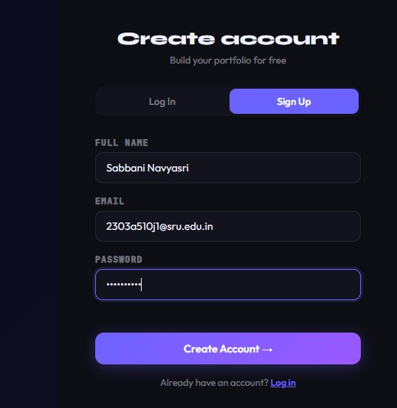
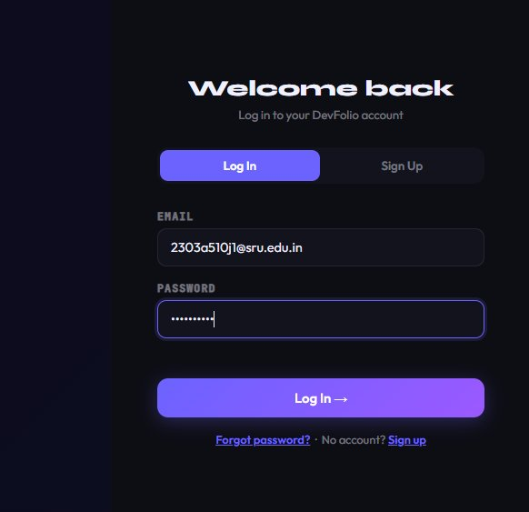
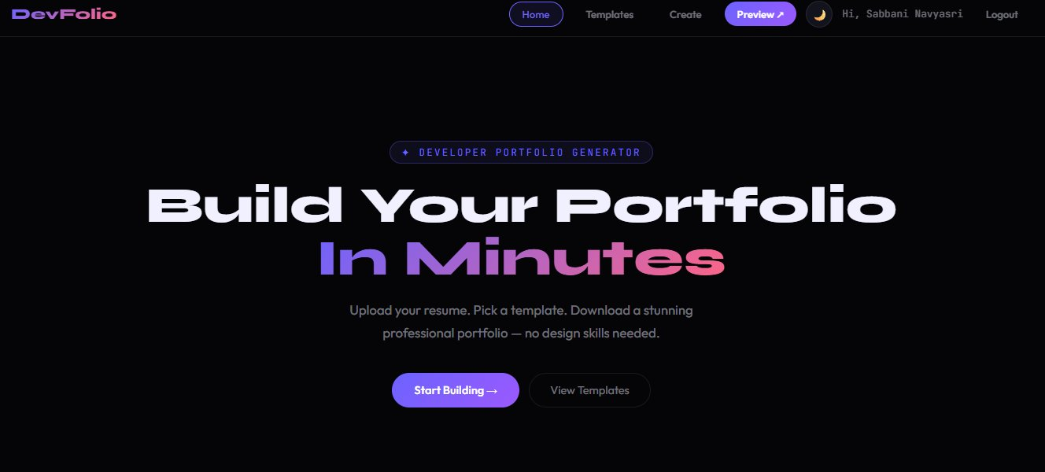
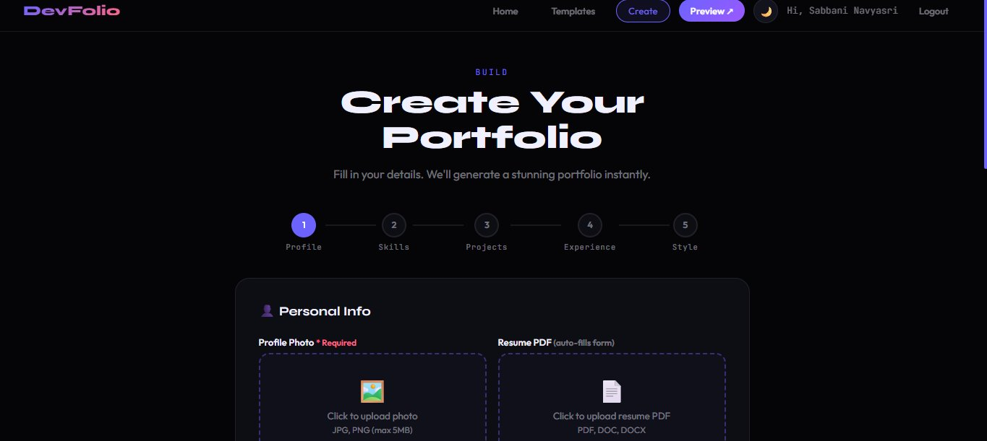
/ 07
Front-End View of Web Application
Sign Up Screen
Log In Screen
Create account · Name / Email / Password · Toggle to Login
Welcome back · Email / Password · Forgot password flow
Home Page
Create Portfolio Wizard
Hero section · Start Building CTA · Navigation bar · Preview ↗
5-step progress · Profile / Skills / Projects / Experience / Style
DevFolio · AI-Powered Portfolio Generator · SRU · 2026

Slide 10
/ 08
Proof of Prompts Generating Codes
DevFolio code was generated using Microsoft Copilot & Google Gemini — below are key prompts and their outputs:
Microsoft Copilot
Google Gemini
buildPortfolio() function
parseResume() function
"Generate 20 portfolio template functions in JS, each returning a complete HTML string from a data object with name, skills, projects, experience and color."
"Write a JS resume parser using PDF.js that extracts name, email, skills (38 keywords), education, experience, projects with date ranges."
function darkPortfolio(bg, accentLine) {
var css = GFP + '*{box-sizing:border-box}body{' + bg + '...}';
var hero = '<div style="padding:64px 0 40px;display:flex...">'
+ ph(120,'50%') + '<h1 style="font-family:Syne...">'
+ d.name + '</h1>' + contactLinks(true) + statsBar + '</div>';
// ... 20 template renderers, 800+ lines generated
}
function parseResume(raw) {
var emails = raw.match(/([\w._%+-]+@[\w.-]+\.[a-zA-Z]{2,})/g)||[];
var skills=[]; TECH.forEach(t => {
if(new RegExp('(?:^|[\s,/(])'+t+'(?:[\s,/)]|$)','im').test(raw))
skills.push(t);
}); // name detection, cert filtering, edu/exp extraction...
return {name,title,email,skills,projects,experience,certificates};
}
Microsoft Copilot
Google Gemini
Auth System
CSS Theme & Styling
"Build a complete localStorage auth flow: signup, login, password reset, session persistence and tab-toggle UI between login and signup forms."
"Style the portfolio generator with a dark theme using CSS custom properties, glassmorphism nav, step progress dots, skill chip toggles, and mobile layout."
function doLogin() {
var email = document.getElementById('li-email').value.trim();
var users = getUsers();
if(!users[email]) { err.textContent='No account found.'; return; }
if(users[email].pass !== pass) { err.textContent='Wrong password.'; return; }
setSession(email); hideAuthPage(); afterLogin(users[email].name);
}
// doSignup(), doReset(), checkAndInit(), setSession() all generated
:root {
--bg:#050508; --surface:#0d0d14; --surface2:#13131e;
--accent:#6c63ff; --accent2:#ff6584; --accent3:#43e97b;
--text:#f0f0ff; --muted:rgba(240,240,255,0.45);
}
/* nav, cards, chips, wizard, auth overlay — 450+ lines */
DevFolio · AI-Powered Portfolio Generator · SRU · 2026

Slide 11
/ 09
References
01
02
Microsoft Copilot
Google Gemini
https://copilot.microsoft.com
https://gemini.google.com
Primary AI tool used to generate application code
AI tool for CSS styling, bio feature & secondary code gen
03
04
PDF.js — Mozilla Foundation
Google Fonts
https://mozilla.github.io/pdf.js
https://fonts.google.com
Resume PDF text extraction engine
Syne, Outfit, JetBrains Mono, Inter typography
05
06
MDN Web Docs
GitHub — Version Control
https://developer.mozilla.org
https://github.com
HTML5, CSS3, JavaScript ES6+ reference documentation
Source code repository and version management
07
08
VS Code — Code Editor
cdnjs — CDN for Libraries
https://code.visualstudio.com
https://cdnjs.cloudflare.com
Primary development environment
Hosted PDF.js and other frontend libraries
Software URL: devfolio.html (local) · AI Tools Used: Microsoft Copilot & Google Gemini · Code: Single-file HTML (3,200+ lines)
DevFolio · AI-Powered Portfolio Generator · SRU · 2026

Slide 12
/ 10
AI Tools, Software URL & Code
✦ AI Tools Used
📁 Code Summary
Microsoft Copilot
3,200+
devfolio.html
Primary code generation — portfolio engine, auth system, resume parser, template renderers
Complete single-file app — HTML, CSS & JS
Google Gemini
~150
Auth System (JS)
doLogin, doSignup, doReset, checkAndInit
CSS styling, bio generation feature, skill gap logic, secondary code review & research
~200
Resume Parser (JS)
Copilot + Gemini
parseResume(), PDF.js integration
Combined for complex features — multi-step wizard, PDF parsing, 20-template routing logic
~800
Portfolio Engine (JS)
20 template renderers + buildPortfolio()
~450
CSS Styling
Variables, nav, cards, wizard, auth overlay
🌐 Software / Website
~50
Skills Grid (JS)
38 tech skills, chip toggle, custom add
Application Type:
Single-File Web Application (HTML + CSS + JS)
~20
AI Bio Function (JS)
Run Method:
Open devfolio.html directly in any browser — no server needed
Claude API fetch with error handling
Hosting:
GitHub Pages / Netlify Drop / Any static host
~60
Template Router (JS)
Total: 1 file · 3,200+ lines · 100% client-side · Zero dependencies to install
20 if/else branches routing to renderers
DevFolio · AI-Powered Portfolio Generator · SRU · 2026

